Slide 1
A Sophomoric Introduction to Shared-Memory Parallelism and Concurrency Lecture 1 Introduction to Multithreading & Fork-Join Parallelism
Steve Wolfman, based on work by Dan Grossman

Slide 2
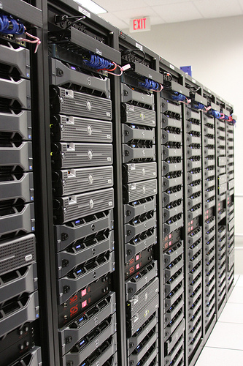
Why Parallelism?
Photo by The Planet, CC BY-SA 2.0
Notes:
Motivate with cloud computing/server clusters/massive parallelism.
See top500.org
Here’s the June 2014 winner; key piece is over 3 million cores
TIANHE-2 (MILKYWAY-2) - TH-IVB-FEP CLUSTER, INTEL XEON E5-2692 12C 2.200GHZ, TH EXPRESS-2, INTEL XEON PHI 31S1P
Site:National Super Computer Center in GuangzhouManufacturer:NUDTCores:3,120,000Linpack Performance (Rmax)33,862.7 TFlop/sTheoretical Peak (Rpeak)54,902.4 TFlop/sNmax9,960,000Power:17,808.00 kWMemory:1,024,000 GBProcessor:Intel Xeon E5-2692v2 12C 2.2GHzInterconnect:TH Express-2Operating System:Kylin LinuxCompiler:iccMath Library:Intel MKL-11.0.0MPI:MPICH2 with a customized GLEX channel

Slide 3
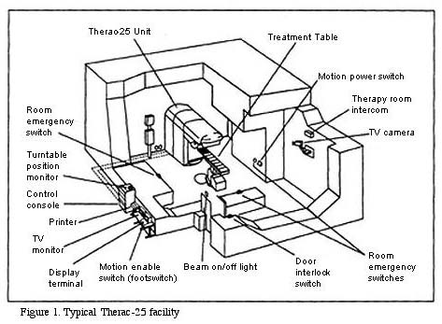
Why not Parallelism?
Photo from case study by William Frey, CC BY 3.0
Concurrency problems were certainly not the only problem here… nonetheless, it’s hard to reason correctly about programs with concurrency.
Moral: Rely as much as possible on high-quality pre-made solutions (libraries).
Photo by The Planet, CC BY-SA 2.0
Notes:
DE-motivate “rolling your own” with example of fatal (three people died) home-grown (well, for us Canadians, anyway, d’oh!) hardware/software accident.
There were LOTS of issues here. But, there’s no question that parallelism contributed.
Key parallelism part APPEARS to be roughly that when “tuning” the magnets in one process, another process ensures that changes in the UI cancel the magnet tuning. However, after the first check for this, subsequent checks do not help, which gives 8 seconds (!!) during the magnet tuning process during which a human action can reset the conditions of the treatment without appropriate safeties (the lead target for a high-dose radiation beam).

Slide 4
Learning Goals
By the end of this unit, you should be able to:
Distinguish between parallelism—improving performance by exploiting multiple processors—and concurrency—managing simultaneous access to shared resources.
Explain and justify the task-based (vs. thread-based) approach to parallelism. (Include asymptotic analysis of the approach and its practical considerations, like "bottoming out" at a reasonable level.)

Slide 5
Outline
History and Motivation
Parallelism and Concurrency Intro
Counting Matches
Parallelizing
Better, more general parallelizing

Slide 6
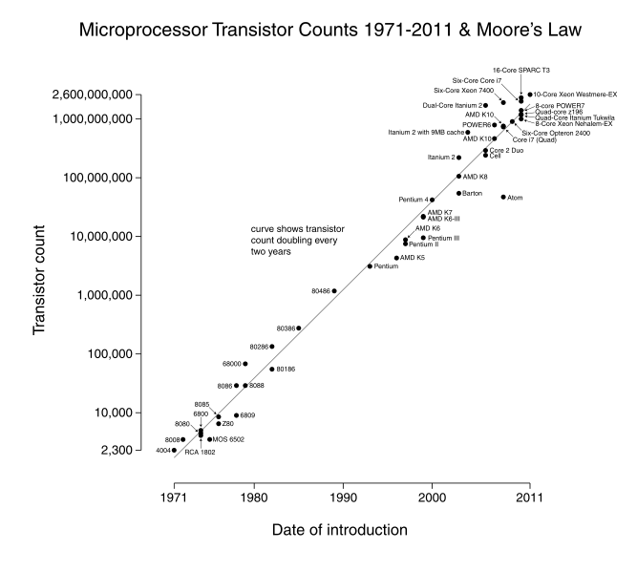
What happens as the transistor count goes up?
Chart by Wikimedia user: Wgsimon
Creative Commons Attribution-Share Alike 3.0 Unported
Notes:
Just get them to throw in their thoughts on what changed. There’s a lot (e.g., diversification in industry!), but the most striking trend is that around 2006 (when exponential sequential speed-up “died”) multi-core computers crop up.
Maybe ask if they’d RATHER have a 2x faster sequential computer or a computer with 2 cores.
TODO: REALLY need a speed chart.
TODO: restart notes here.

Slide 7
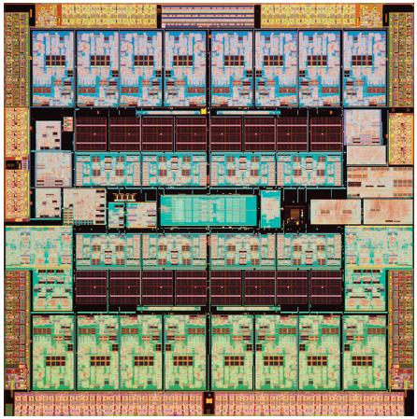
(zoomed in)
(Sparc T3 micrograph from Oracle; 16 cores. )
Chart by Wikimedia user: Wgsimon
Creative Commons Attribution-Share Alike 3.0 Unported
Notes:
Writing multi-threaded code in common languages like Java and C is more difficult than single-threaded (sequential) code.
So, as long as possible (~1980-2005), desktop computers’ speed running sequential programs doubled every ~2 years.
Although we keep making transistors/wires smaller, we don’t know how to continue the speed increases:
Increasing clock rate generates too much heat
Relative cost of memory access is too high
Solution, not faster but smaller and more…

Slide 8
(Goodbye to) Sequential Programming
One thing happens at a time.
The next thing to happen is “my” next instruction.
Removing these assumptions creates challenges & opportunities:
How can we get more work done per unit time (throughput)?
How do we divide work among threads of execution and coordinate (synchronize) among them?
How do we support multiple threads operating on data simultaneously (concurrent access)?
How do we do all this in a principled way? (Algorithms and data structures, of course!)

Slide 9
What to do with multiple processors?
Run multiple totally different programs at the same time
(Already doing that, but with time-slicing.)
Do multiple things at once in one program
Requires rethinking everything from asymptotic complexity to how to implement data-structure operations

Slide 10
Outline
History and Motivation
Parallelism and Concurrency Intro
Counting Matches
Parallelizing
Better, more general parallelizing

Slide 11
KP Duty: Peeling Potatoes, Parallelism
How long does it take a person to peel one potato? Say: 15s
How long does it take a person to peel 10,000 potatoes? ~2500 min = ~42hrs = ~one week full-time.
How long would it take 100 people with 100 potato peelers to peel 10,000 potatoes?
Notes:
Get beyond just the calculation. Discuss fixed setup cost for each person, distribution of resources, etc. Be sure to get to the point that there will be some downtime!

Slide 12
KP Duty: Peeling Potatoes, Parallelism
How long does it take a person to peel one potato? Say: 15s
How long does it take a person to peel 10,000 potatoes? ~2500 min = ~42hrs = ~one week full-time.
How long would it take 100 people with 100 potato peelers to peel 10,000 potatoes?
Parallelism: using extra resources to solve a problem faster.
Note: these definitions of “parallelism” and “concurrency” are not yet standard but the perspective is essential to avoid confusion!

Slide 13
Parallelism Example
Parallelism: Use extra computational resources to solve a problem faster (increasing throughput via simultaneous execution)
Pseudocode for counting matches
Bad style for reasons we’ll see, but may get roughly 4x speedup
int cm_parallel(int arr[], int len, int target){
res = new int[4];
FORALL(i=0; i < 4; i++) { //parallel iterations
res[i] = count_matches(arr + i*len/4, (i+1)*len/4 – i*len/4, target);
}
return res[0]+res[1]+res[2]+res[3];
}
int count_matches(int arr[], int len, int target) {
// normal sequential code to count matches of
// target.
}

Slide 14
KP Duty: Peeling Potatoes, Concurrency
How long does it take a person to peel one potato? Say: 15s
How long does it take a person to peel 10,000 potatoes? ~2500 min = ~42hrs = ~one week full-time.
How long would it take 4 people with 3 potato peelers to peel 10,000 potatoes?

Slide 15
KP Duty: Peeling Potatoes, Concurrency
How long does it take a person to peel one potato? Say: 15s
How long does it take a person to peel 10,000 potatoes? ~2500 min = ~42hrs = ~one week full-time.
How long would it take 4 people with 3 potato peelers to peel 10,000 potatoes?
Concurrency: Correctly and efficiently manage access to shared resources
(Better example: Lots of cooks in one kitchen, but only 4 stove burners. Want to allow access to all 4 burners, but not cause spills or incorrect burner settings.)
Note: these definitions of “parallelism” and “concurrency” are not yet standard but the perspective is essential to avoid confusion!

Slide 16
Concurrency Example
Concurrency: Correctly and efficiently manage access to shared resources (from multiple possibly-simultaneous clients)
Pseudocode for a shared chaining hashtable
Prevent bad interleavings (correctness)
But allow some concurrent access (performance)
template <typename K, typename V> class Hashtable<K,V> {
…
void insert(K key, V value) {
int bucket = …;
prevent-other-inserts/lookups in table[bucket]
do the insertion
re-enable access to table[bucket]
}
V lookup(K key) {
(like insert, but can allow concurrent
lookups to same bucket)
}
}
Notes:
If there’s time, we will return to this!

Slide 17
OLD Memory Model
Dynamically allocated data.
pc=…
Local variables Control flow info
The Stack
…
The Heap
(pc = program counter, address of current instruction)

Slide 18
Shared Memory Model
We assume (and C++11 specifies) shared memory w/explicit threads
NEW story:
Dynamically allocated data.
PER THREAD: Local variables Control flow info
pc=…
…
pc=…
pc=…
A Stack
…
…
…
A Stack
A Stack
The Heap
Note: we can share local variables by sharing pointers to their locations.

Slide 19
Other models
We will focus on shared memory, but you should know several other models exist and have their own advantages
Message-passing: Each thread has its own collection of objects. Communication is via explicitly sending/receiving messages
Cooks working in separate kitchens, mail around ingredients
Dataflow: Programmers write programs in terms of a DAG.
A node executes after all of its predecessors in the graph
Cooks wait to be handed results of previous steps
Data parallelism: Have primitives for things like “apply function to every element of an array in parallel”
Note: our parallelism solution will have a “dataflow feel” to it.

Slide 20
Outline
History and Motivation
Parallelism and Concurrency Intro
Counting Matches
Parallelizing
Better, more general parallelizing

Slide 21
Problem: Count Matches of a Target
How many times does the number 3 appear?
3 | 5 | 9 | 3 | 2 | 0 | 4 | 6 | 1 | 3
// Basic sequential version.
int count_matches(int array[], int len, int target) {
int matches = 0;
for (int i = 0; i < len; i++) {
if (array[i] == target)
matches++;
}
return matches;
}
How can we take advantage of parallelism?

Slide 22
First attempt (wrong.. but grab the code!)
void cmp_helper(int * result, int array[],
int lo, int hi, int target) {
*result = count_matches(array + lo, hi - lo, target);
}
int cm_parallel(int array[], int len, int target) {
int divs = 4;
std::thread workers[divs];
int results[divs];
for (int d = 0; d < divs; d++)
workers[d] = std::thread(&cmp_helper, &results[d], array, (d*len)/divisions, ((d+1)*len)/divisions, target);
int matches = 0;
for (int d = 0; d < divs; d++)
matches += results[d];
return matches;
}
Notice: we use a pointer to shared memory to communicate across threads!
BE CAREFUL sharing memory!

Slide 23
Shared Memory: Data Races
void cmp_helper(int * result, int array[],
int lo, int hi, int target) {
*result = count_matches(array + lo, hi - lo, target);
}
int cm_parallel(int array[], int len, int target) {
int divs = 4;
std::thread workers[divs];
int results[divs];
for (int d = 0; d < divs; d++)
workers[d] = std::thread(&cmp_helper, &results[d], array, (d*len)/divisions, ((d+1)*len)/divisions, target);
int matches = 0;
for (int d = 0; d < divs; d++)
matches += results[d];
return matches;
}
Race condition: What happens if one thread tries to write to a memory location while another reads (or multiple try to write)? KABOOM (possibly silently!)

Slide 24
Shared Memory and Scope/Lifetime
void cmp_helper(int * result, int array[],
int lo, int hi, int target) {
*result = count_matches(array + lo, hi - lo, target);
}
int cm_parallel(int array[], int len, int target) {
int divs = 4;
std::thread workers[divs];
int results[divs];
for (int d = 0; d < divs; d++)
workers[d] = std::thread(&cmp_helper, &results[d], array, (d*len)/divisions, ((d+1)*len)/divisions, target);
int matches = 0;
for (int d = 0; d < divs; d++)
matches += results[d];
return matches;
}
Scope problems: What happens if the child thread is still using the variable when it is deallocated (goes out of scope) in the parent? KABOOM (possibly silently??)

Slide 25
Run the Code!
void cmp_helper(int * result, int array[],
int lo, int hi, int target) {
*result = count_matches(array + lo, hi - lo, target);
}
int cm_parallel(int array[], int len, int target) {
int divs = 4;
std::thread workers[divs];
int results[divs];
for (int d = 0; d < divs; d++)
workers[d] = std::thread(&cmp_helper, &results[d], array, (d*len)/divisions, ((d+1)*len)/divisions, target);
int matches = 0;
for (int d = 0; d < divs; d++)
matches += results[d];
return matches;
}
Now, let’s run it.
KABOOM! What happens, and how do we fix it?
Notes:
Kaboom! What’s C++11’s problem? The scope issue… which also gives us a hint of how to deal with the data race.
Insert joins and fix.

Slide 26
Fork/Join Parallelism
std::thread defines methods you could not implement on your own
The constructor calls its argument in a new thread (forks)

Slide 27
Fork/Join Parallelism
std::thread defines methods you could not implement on your own
The constructor calls its argument in a new thread (forks)
fork!

Slide 28
Fork/Join Parallelism
std::thread defines methods you could not implement on your own
The constructor calls its argument in a new thread (forks)
fork!

Slide 29
Fork/Join Parallelism
std::thread defines methods you could not implement on your own
The constructor calls its argument in a new thread (forks)

Slide 30
Fork/Join Parallelism
std::thread defines methods you could not implement on your own
The constructor calls its argument in a new thread (forks)
join blocks until/unless the receiver is done executing (i.e., its constructor’s argument function returns)
join!

Slide 31
Fork/Join Parallelism
std::thread defines methods you could not implement on your own
The constructor calls its argument in a new thread (forks)
join blocks until/unless the receiver is done executing (i.e., its constructor’s argument function returns)
This thread is stuck until the other one finishes.
join!

Slide 32
Fork/Join Parallelism
std::thread defines methods you could not implement on your own
The constructor calls its argument in a new thread (forks)
join blocks until/unless the receiver is done executing (i.e., its constructor’s argument function returns)
join!
This thread could already be done (joins immediately) or could run for a long time.

Slide 33
Join
std::thread defines methods you could not implement on your own
The constructor calls its argument in a new thread (forks)
join blocks until/unless the receiver is done executing (i.e., its constructor’s argument function returns)
a fork
a join
And now the thread proceeds normally.

Slide 34
Second attempt (patched!)
int cm_parallel(int array[], int len, int target) {
int divs = 4;
std::thread workers[divs];
int results[divs];
for (int d = 0; d < divs; d++)
workers[d] = std::thread(&cmp_helper, &results[d], array, (d*len)/divisions, ((d+1)*len)/divisions, target);
int matches = 0;
for (int d = 0; d < divs; d++) {
workers[d].join();
matches += results[d];
}
return matches;
}

Slide 35
Outline
History and Motivation
Parallelism and Concurrency Intro
Counting Matches
Parallelizing
Better, more general parallelizing

Slide 36
Success! Are we done?
Answer these:
What happens if I run my code on an old-fashioned one-core machine?
What happens if I run my code on a machine with more cores in the future?
(Done? Think about how to fix it and do so in the code.)

Slide 37
Chopping (a Bit) Too Fine
3s
12
secs
of
work
3s
3s
3s
We thought there were 4 processors available.
But there’s only 3.
Result?

Slide 38
Chopping Just Right
4s
12
secs
of
work
4s
4s
We thought there were 3 processors available.
And there are.
Result?

Slide 39
Success! Are we done?
Answer these:
What happens if I run my code on an old-fashioned one-core machine?
What happens if I run my code on a machine with more cores in the future?
Let’s fix these!
(Note: std::thread::hardware_concurrency() and omp_get_num_procs().)

Slide 40
Success! Are we done?
Answer this:
Might your performance vary as the whole class tries problems, depending on when you start your run?
(Done? Think about how to fix it and do so in the code.)

Slide 41
Is there a “Just Right”?
4s
12
secs
of
work
I’m busy.
4s
I’m busy.
4s
We thought there were 3 processors available.
And there are, sort of.
Result?

Slide 42
Chopping So Fine It’s Like Sand or Water
(of course, we can’t predict the busy times!)
12
secs
of
work
I’m busy.
…
I’m busy.
…
We chopped into 10,000 pieces.
And there are a few processors.
Result?

Slide 43
Analyzing Performance
void cmp_helper(int * result, int array[],
int lo, int hi, int target) {
*result = count_matches(array + lo, hi - lo, target);
}
int cm_parallel(int array[], int len, int target) {
int divs = len;
std::thread workers[divs];
int results[divs];
for (int d = 0; d < divs; d++)
workers[d] = std::thread(&cmp_helper, &results[d], array, (d*len)/divisions, ((d+1)*len)/divisions, target);
int matches = 0;
for (int d = 0; d < divs; d++)
matches += results[d];
return matches;
}
Yes, this is silly.
We’ll justify later.
It’s Asymptotic Analysis Time! (n == len, # of processors = ∞)
How long does dividing up/recombining the work take?

Slide 44
Analyzing Performance
void cmp_helper(int * result, int array[],
int lo, int hi, int target) {
*result = count_matches(array + lo, hi - lo, target);
}
int cm_parallel(int array[], int len, int target) {
int divs = len;
std::thread workers[divs];
int results[divs];
for (int d = 0; d < divs; d++)
workers[d] = std::thread(&cmp_helper, &results[d], array, (d*len)/divisions, ((d+1)*len)/divisions, target);
int matches = 0;
for (int d = 0; d < divs; d++)
matches += results[d];
return matches;
}
How long does doing the work take? (n == len, # of processors = ∞)
(With n threads, how much work does each one do?)

Slide 45
Analyzing Performance
void cmp_helper(int * result, int array[],
int lo, int hi, int target) {
*result = count_matches(array + lo, hi - lo, target);
}
int cm_parallel(int array[], int len, int target) {
int divs = len;
std::thread workers[divs];
int results[divs];
for (int d = 0; d < divs; d++)
workers[d] = std::thread(&cmp_helper, &results[d], array, (d*len)/divisions, ((d+1)*len)/divisions, target);
int matches = 0;
for (int d = 0; d < divs; d++)
matches += results[d];
return matches;
}
Time ∈ Θ(n) with an infinite number of processors?
That sucks!

Slide 46

Zombies Seeking Help
A group of (non-CSist) zombies wants your help infecting the living. Each time a zombie bites a human, it gets to transfer a program.
The new zombie in town has the humans line up and bites each in line, transferring the program: Do nothing except say “Eat Brains!!”
Analysis?
How do they do better?
Asymptotic analysis was so much easier with a brain!

Slide 47
A better idea
+
+
+
+
+
+
+
+
+
+
+
+
+
+
+
The zombie apocalypse is straightforward using divide-and-conquer
Note: the natural way to code it is to fork two tasks, join them, and get results. But… the natural zombie way is to bite one human and then each “recurse”.
(As is so often true, the zombie way is better.)

Slide 48
Divide-and-Conquer Style Code (doesn’t work in general... more on that later)
void cmp_helper(int * result, int array[],
int lo, int hi, int target) {
if (len <= 1) {
*result = count_matches(array + lo, hi-lo, target);
return;
}
int left, right;
int mid = lo + (hi-lo)/2;
std::thread child(&cmp_helper, &left, array, lo,
mid, target);
cmp_helper(&right, array, mid, hi, target);
child.join();
return left + right;
}
int cm_parallel(int array[], int len, int target) {
int result;
cmp_helper(&result, array, 0, len, target);
return result;
}

Slide 49
Analysis of D&C Style Code
void cmp_helper(int * result, int array[],
int lo, int hi, int target) {
if (len <= 1) {
*result = count_matches(array + lo, hi-lo, target);
return;
}
int left, right;
int mid = lo + (hi-lo)/2;
std::thread child(&cmp_helper, &left, array, lo,
mid, target);
cmp_helper(&right, array, mid, hi, target);
child.join();
return left + right;
}
int cm_parallel(int array[], int len, int target) {
int result;
cmp_helper(&result, array, 0, len, target);
return result;
}
It’s Asymptotic Analysis Time! (n == len, # of processors = ∞)
How long does dividing up/recombining the work take? Um…?

Slide 50
Easier Visualization for the Analysis
+
+
+
+
+
+
+
+
+
+
+
+
+
+
+
How long does the tree take to run… …with an infinite number of processors?
(n is the width of the array)

Slide 51
Analysis of D&C Style Code
void cmp_helper(int * result, int array[],
int lo, int hi, int target) {
if (len <= 1) {
*result = count_matches(array + lo, hi-lo, target);
return;
}
int left, right;
int mid = lo + (hi-lo)/2;
std::thread child(&cmp_helper, &left, array, lo,
mid, target);
cmp_helper(&right, array, mid, hi, target);
child.join();
return left + right;
}
int cm_parallel(int array[], int len, int target) {
int result;
cmp_helper(&result, array, 0, len, target);
return result;
}
How long does doing the work take? (n == len, # of processors = ∞)
(With n threads, how much work does each one do?)

Slide 52
Analysis of D&C Style Code
void cmp_helper(int * result, int array[],
int lo, int hi, int target) {
if (len <= 1) {
*result = count_matches(array + lo, hi-lo, target);
return;
}
int left, right;
int mid = lo + (hi-lo)/2;
std::thread child(&cmp_helper, &left, array, lo,
mid, target);
cmp_helper(&right, array, mid, hi, target);
child.join();
return left + right;
}
int cm_parallel(int array[], int len, int target) {
int result;
cmp_helper(&result, array, 0, len, target);
return result;
}
Time ∈ Θ(lg n) with an infinite number of processors.
Exponentially faster than our Θ(n) solution! Yay!
So… why doesn’t the code work?

Slide 53
Chopping Too Fine Again
12
secs
of
work
…
…
We chopped into n pieces (n == array length).
Result?

Slide 54
KP Duty: Peeling Potatoes, Parallelism Reminder
How long does it take a person to peel one potato? Say: 15s
How long does it take a person to peel 10,000 potatoes? ~2500 min = ~42hrs = ~one week full-time.
How long would it take 100 people with 100 potato peelers to peel 10,000 potatoes?
Notes:
Get beyond just the calculation. Discuss fixed setup cost for each person, distribution of resources, etc. Be sure to get to the point that there will be some downtime!

Slide 55
KP Duty: Peeling Potatoes, Parallelism Problem
How long does it take a person to peel one potato? Say: 15s
How long does it take a person to peel 10,000 potatoes? ~2500 min = ~42hrs = ~one week full-time.
How long would it take 10,000 people with 10,000 potato peelers to peel 10,000 potatoes?

Slide 56
KP Duty: Peeling Potatoes, Parallelism Problem
How long does it take a person to peel one potato? Say: 15s
How long does it take a person to peel 10,000 potatoes? ~2500 min = ~42hrs = ~one week full-time.
How long would it take 10,000 people with 10,000 potato peelers to peel 10,000 potatoes?
How much time do we spend finding places for people to work, handing out peelers, giving instructions, teaching technique, bandaging wounds, and (ack!) filling out paperwork?

Slide 57
Being realistic
Creating one thread per element is way too expensive.
So, we use a library where we create “tasks” (“bite-sized” pieces of work) that the library assigns to a “reasonable” number of threads.

Slide 58
Being realistic
Creating one thread per element is way too expensive.
So, we use a library where we create “tasks” (“bite-sized” pieces of work) that the library assigns to a “reasonable” number of threads.
But… creating one task per element still too expensive.
So, we use a sequential cutoff, typically ~500-1000. (This is like switching from quicksort to insertion sort for small subproblems.)
Note: we’re still chopping into Θ(n) pieces, just not into n pieces.

Slide 59
Being realistic: Exercise
How much does a sequential cutoff help?
With 1,000,000,000 (~2³⁰) elements in the array and a cutoff of 1: About how many tasks do we create?
With 1,000,000,000 elements in the array and a cutoff of 16 (a ridiculously small cutoff): About how many tasks do we create?
What percentage of the tasks do we eliminate with our cutoff?
Notes:
Remember, one for every node in the tree… but half of the nodes in the tree are at the fringe!

Slide 60
That library, finally
C++11’s threads are usually too “heavyweight” (implementation dependent).
OpenMP version 3.0’s main contribution was to meet the needs of divide-and-conquer fork-join parallelism
Available in recent g++’s.
See provided code and notes for details.
Efficient implementation is a fascinating but advanced topic!

Slide 61
Learning Goals
By the end of this unit, you should be able to:
Distinguish between parallelism—improving performance by exploiting multiple processors—and concurrency—managing simultaneous access to shared resources.
Explain and justify the task-based (vs. thread-based) approach to parallelism. (Include asymptotic analysis of the approach and its practical considerations, like "bottoming out" at a reasonable level.)
P.S. We promised we’d justify assuming # processors = ∞.
Next lecture!

Slide 62
Outline
History and Motivation
Parallelism and Concurrency Intro
Counting Matches
Parallelizing
Better, more general parallelizing
Bonus code and parallelism issue!

Slide 63
Example: final version
int cmp_helper(int array[], int len, int target) {
const int SEQUENTIAL_CUTOFF = 1000;
if (len <= SEQUENTIAL_CUTOFF)
return count_matches(array, len, target);
int left, right;
#pragma omp task untied shared(left)
left = cmp_helper(array, len/2, target);
right = cmp_helper(array+len/2, len-(len/2), target);
#pragma omp taskwait
return left + right;
}
int cm_parallel(int array[], int len, int target) {
int result;
#pragma omp parallel
#pragma omp single
result = cmp_helper(array, len, target);
return result;
}

Slide 64
Side Note: Load Imbalance
Does each “bite-sized piece of work” take the same time to run:
When counting matches?
When counting the number of prime numbers in the array?
Compare the impact of different runtimes on the “chop up perfectly by the number of processors” approach vs. “chop up super-fine”.

